Slide 1
detachment adjutant
The Communication Hub

Slide 2
What do YOU think the Adjutant duties are?

Slide 3
More than a secretary
Adjutant
Officers
Paymaster
Members
Department

Slide 4
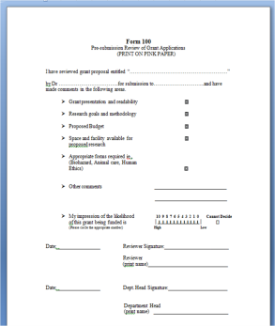
Note taking – secretarial part
Making phone calls – communicating
Filling out forms - Report of Officer Installation (ROI) / maybe transmittals / department reports / State or Federal filings
Assisting detachment staff – paymaster / Commandant / members

Slide 5
Creating agenda for meeting – assisting Commandant
Emailing information – communicating
Keeping Records – physical or digital records of meetings / motions / decisions / membership / filings / past activities

Slide 6
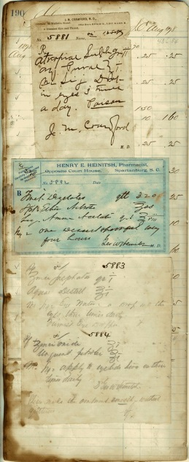
Records – corporate documents for State
or Federal purposes as a legal entity
Audit – having documents ready for an audit
should one be needed by detachment / department /
national / State / Federal

Slide 7
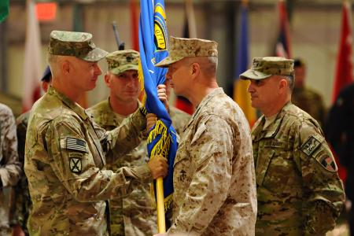
Remember Information – be able to find / recall /
produce information for the membership
Change of Command – document voting / filing of forms / accuracy

Slide 8
Minutes
Show that a quorum was met.
Follow the order of business as it took place.
Accurately record motions and voting of the membership.
General discussion of topics.
Awards / Presentations.
Time / Place of meeting.

Slide 9
Records
Keep a copy of all records –
Minutes
Newsletters
Membership
Rosters
Transmittals
Report of Officer Installations
Quarterly Reports
Ceremonial Rifle reporting
Volunteer hours
Funerals
Eagle Scout awards
Other detachment activities
Recommend digital copies of records – make a back up
Paper copies – keep in a common area
All records must be passed on to the next person in that position

Slide 10
Rosters
Keep a Detachment Roster of your own
Compare the National Roster to your Detachment Roster
Keep different categories for easy reporting
Full roster
PLM roster
Past members
Potential members
Details for each member such as…Membership / PLM #; Address / contact info; DOB; service years; date dues paid

Slide 11
forms
Report of Officer Installation (ROI)
Elections are to be done annually! (between 1 Sept and 15 May)
ROI should be submitted in a timely manner. (received by 30 June)
Transmittal – Dues / Name – Address changes / Transfers
This to be done as needed in a timely manner.
Numbering to restart each July.
Quarterly Reports
Get data from each committee.
Report of Death
Assist Chaplain with information to fill out report.
State Corporation forms
Assist Paymaster with keeping these forms updated.
Federal IRS filings
Assist Paymaster with filing of 990 or other forms.
If you have Rifles
File / Assist with filing the tri-annual documents

Slide 12
Questions???

